Slide 1


KAIST
Technical Interview Workshop
Part II
Yongwhan Lim
Senior Quantitative Software Engineer at Two Sigma
8pm KST, Thursday, July 14, 2022

Slide 2






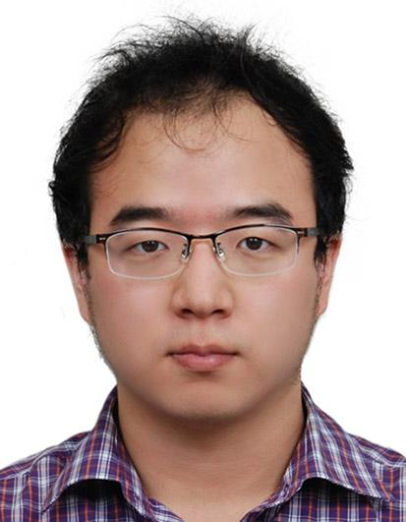
Yongwhan Lim
Currently:
Senior Quantitative Software Engineer at Two Sigma
Lecturer in EECS at MIT
Research Mentor in SIMR at Harvard University
Associate in Computer Science at Columbia University
ICPC Head Coach at Columbia University
ICPC Judge for Greater New York Mid-Central Regionals in N.A.
Previously:
Research Software Engineer at Google Research
Education:
Stanford: Math & CS (BS '11) and CS (MS '13)
MIT: Operations Research (PhD, started in 2013 but on an extended leave-of-absence since 2016)
https://www.cs.columbia.edu/~yongwhan/

Slide 3
Overview
Part I
Behavioral interview (must for any SWE)
System design interview (> entry level)
Machine learning interview (ML engineer)
Part II: Questions & Answers (Q & A)

Slide 4
Part I

Slide 5
Part I-A
Behavioral

Slide 6
Behavioral Interview (for everyone)
At least one session in typical non-entry level Software Engineer (SWE) interview loop.
Wants to learn leadership potential.
Tests soft skills (e.g., effective communication, conflict resolution, etc.)
Open-ended: not about right or wrong!

Slide 7
Example Question #1
Tell me about a time when you led a team to successfully complete a project.

Slide 8
Example Question #1: Sample Answer
Best if you led a hackathon/passion project.
Otherwise, if you led a project as an intern, highlight it.
Be concise
Include hard metrics (in terms of %, $, etc).
Provide concrete example.

Slide 9
Example Question #2
How do you set up priorities for the work you are facing each day?

Slide 10
Example Question #2: Sample Answer
Priority queue idea:
Most essential responsibilities first!
Respond to emergencies as needed.
Non-essential tasks can be delayed.

Slide 11
Resources
There are number of preparation books.
For example:
Behavioral Interview Questions and Answers by Horatio Bird.
Leadership Interview Questions You'll Most Likely Be Asked by Vibrant Publishers

Slide 12
Part I-B
System Design

Slide 13
System Design Interview (for > entry level)
Identify large components of the system and describe how each component is connected.
Actual implementation details are not as important.
Tests whether you can design an architecture using standard design patterns.

Slide 14
Example Question #1
Design YouTube

Slide 15
Example Question #2
Design Instagram

Slide 16
Resources
Must reads are:
The System Design Interview, 2nd Edition by Lewis C. Lin, et. al.
System Design Interview by Alex Xu

Slide 17
Resources
Must reads are:
The System Design Interview, 2nd Edition by Lewis C. Lin, et. al.
System Design Interview by Alex Xu
If you have time to dig deeper, consider:
Understanding Distributed Systems by Roberto Vitillo
Designing Data-Intensive Applications by Martin Kleppmann

Slide 18
Part I-C
Machine Learning

Slide 19
Machine Learning Interview (for ML SWE)
Hands-on experience using TensorFlow/Keras/PyTorch: comfortable using data to feed into a baseline model.
ML foundations (e.g., linear regression, support vector machine, etc.)
Recent trends (reinforcement/deep learning)

Slide 20
Machine Learning Interview (for ML SWE)
Hands-on experience using TensorFlow/Keras/PyTorch: comfortable using data to feed into a baseline model.
ML foundations (e.g., linear regression, support vector machine, etc.)
Recent trends (reinforcement/deep learning)
In-depth knowledge of a specialization can be a plus, but not required (e.g., computer vision, natural language processing, etc.).

Slide 21
Example Question (Theory)
What is a difference between unsupervised learning vs supervised learning?

Slide 22
Example Question (Hands-on)
How do you avoid overfitting? implementation: given stock trends, predict the future stock price.

Slide 23
Example Question (Implementation)
Given stock trends, predict the future stock price.

Slide 24
(Must!) Resources
Textbooks
Deep Learning, Ian Goodfellow and Yoshua Bengio and Aaron Courville
Courses
CS 229: Machine Learning, Stanford, Andrew Ng
Tools
PyTorch, Keras, TensorFlow

Slide 25
Part II: Q&A's

Slide 26
Q & A's
What are some tips to be successful in the interview process at Google?

Slide 27
Q & A's
What are some good questions to ask after the interview?

Slide 28
Q & A's
How should I communicate with interviewer during interview?

Slide 29
Q & A's
What are the good and bad examples of a technical interview?

Slide 30
Q & A's
Is LeetCode enough for preparing the technical interview?

Slide 31
Q & A's
What do you do if you do not know how to solve the problem?

Slide 32
Q & A's
What technologies do you use at Google?

Slide 33
Q & A's
(COVID) How is virtual tech interview different from the in-person interview?

Slide 34
Mock Interview Opportunity!
If you attended both Part I and Part II of this special workshop, you are invited to do a mock interview with me should you like to.
The link to the request form is https://forms.gle/8gCg3Te8GCsMYgHWA.

Slide 35
Contact Information
yongwhan@mit.edu or yongwhan.lim@columbia.edu
https://cs.columbia.edu/~yongwhan
https://www.linkedin.com/in/yongwhan/

